Slide 1
RL Foundations: Practical
AI BootCamp

Slide 2
Outline
Review
Exploration vs Exploitation
Reward
Reward shaping
Terminal Condition
Problems arising from bad reward shaping
Environments & Libraries
Q Learning
Deep Q Learning

Slide 3
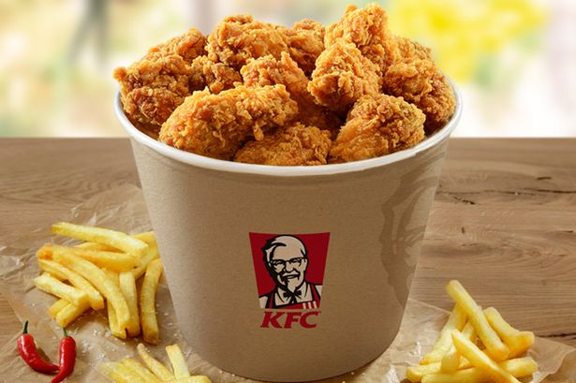
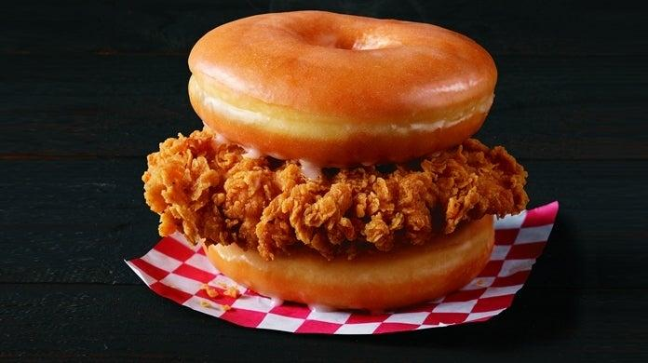
Exploration vs Exploitation: Choosing food
Delicious standard spicy wings
Chicken sandwich with donuts
or

Slide 4
Questions
How would you approach exploitation vs exploration? Consider also that the way you approach it should be implemented mathematically.

Slide 5
Exploration vs Exploitation: Simple example
On Sundays: Try out new food (exploration) On other days of week: Eat the food you like the most (exploitation)

Slide 6
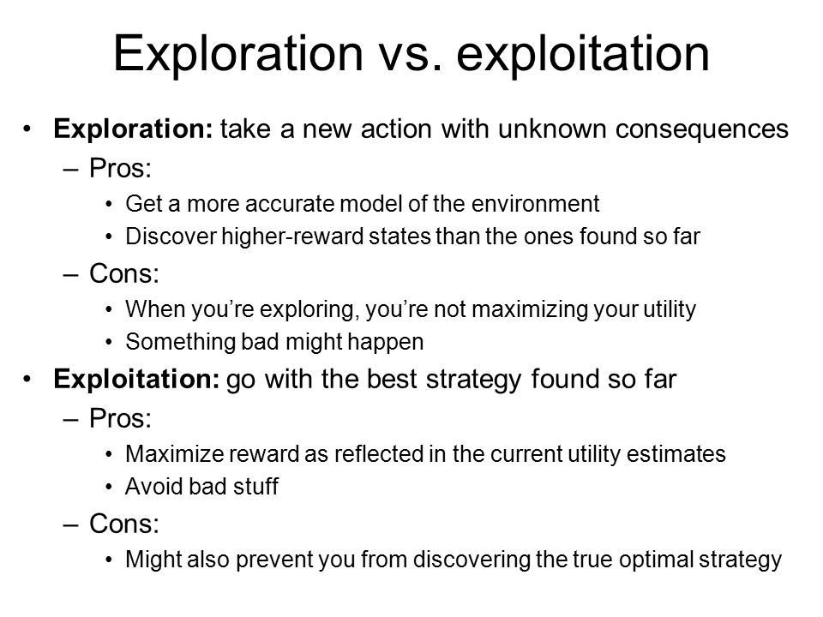

Slide 7
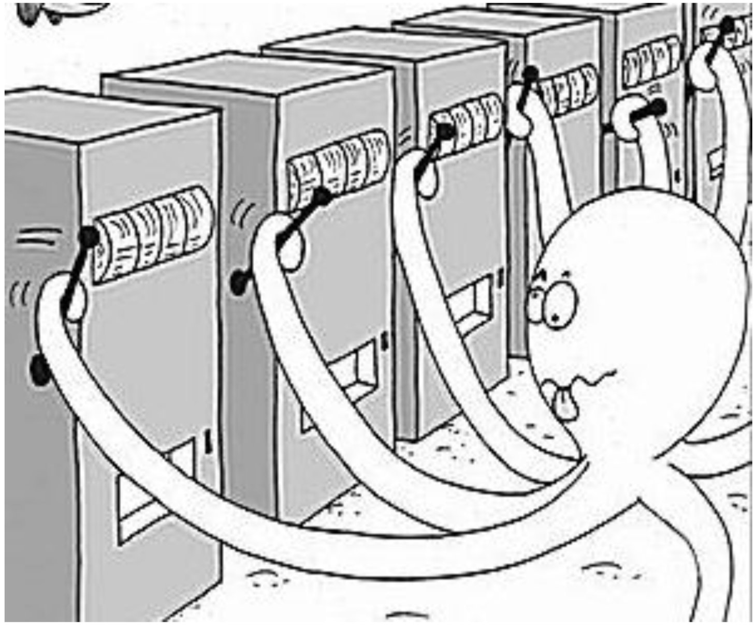
Multi-armed bandit problem

Slide 8
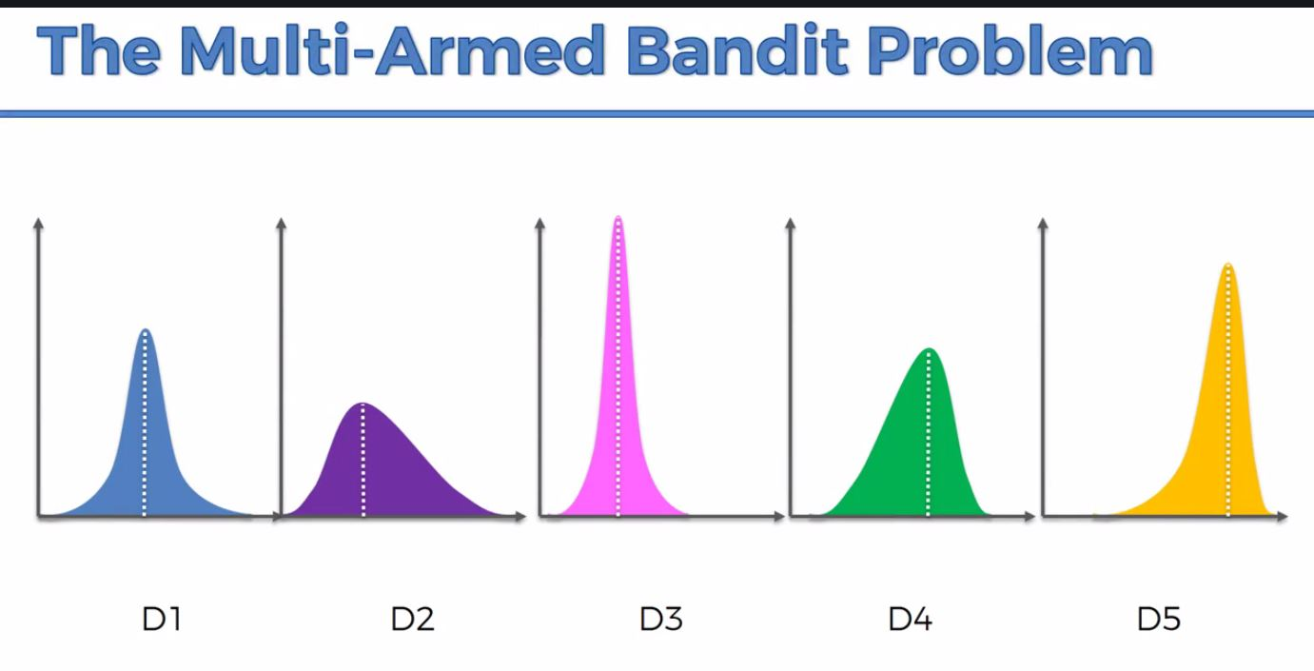

Slide 9
Reward shaping: sparse vs gradual
Rewards that are received rarely or once per episode are called sparse rewards.
Example:
Chess - +1 for winning, -1 for losing, 0 for draw

Slide 10

Example: Hot-Cold game
Hot-Cold game:
N*N sized grid. Prize is in one of the cells.
Agent starts in one of the cells, his action space is up, down, left, right
The goal is to find find the prize
Solution:
Distance based Reward
Reward = - Distance (Prize - Current Location)
S
P

Slide 11
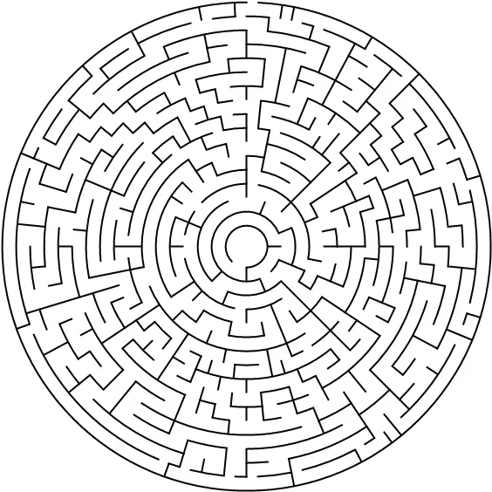
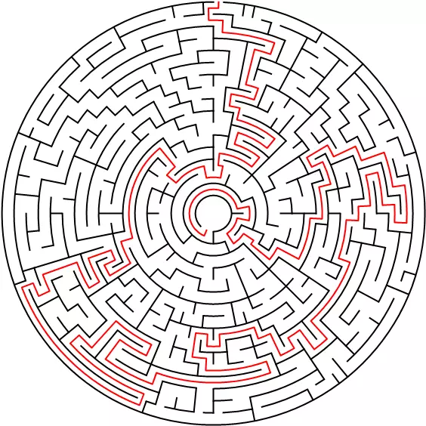
Labyrinth
Partially can be mitigated by good exploration strategy

Slide 12
Terminal state
How to choose when to end episode?
Positive trigger
Negative trigger
Time trigger

Slide 13
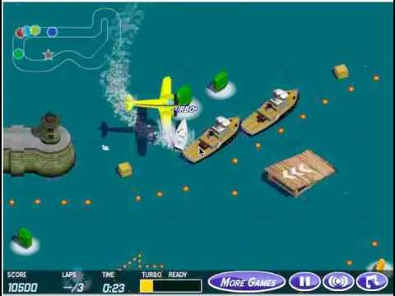
Problems: Reward exploitation

Slide 14
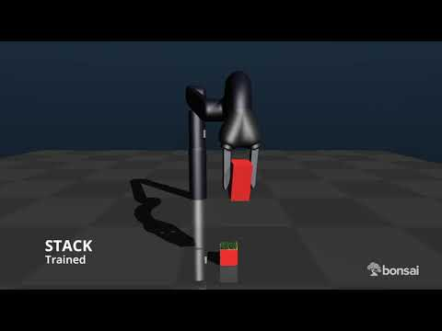
Reward exploitation 2: Bons.ai
Fail:1
Fail:2

Slide 15

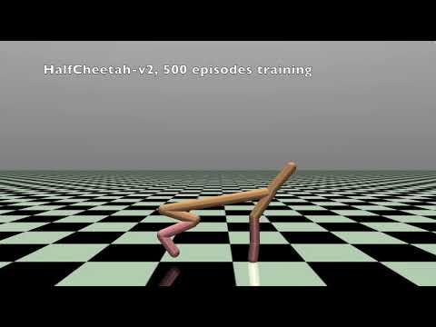
Problems: Local Optima problems

Slide 16
Questions
How would you reassign following rewards from last lecture in a smart way

Slide 17
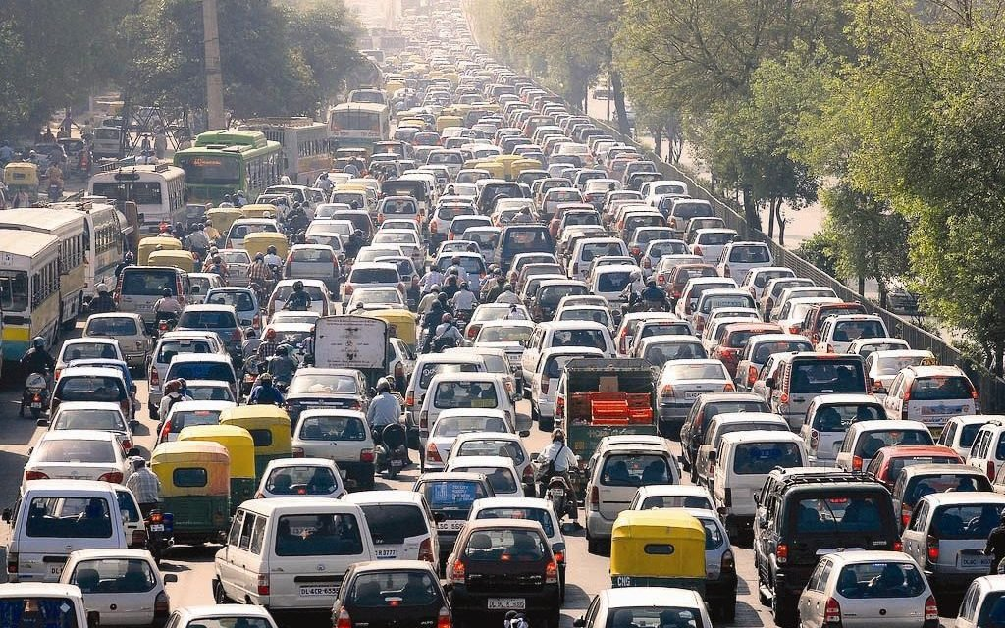
Reward: -2

Slide 18
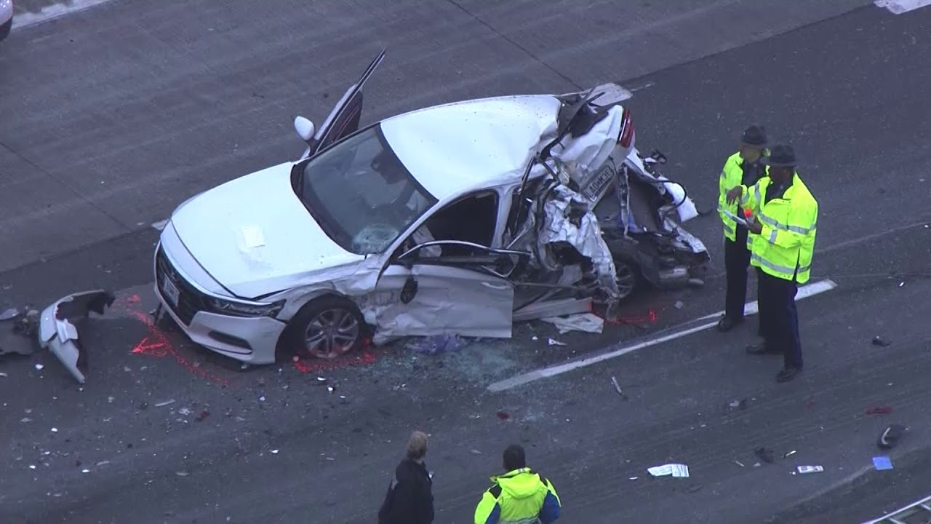
Reward: -5

Slide 19

Reward: -40

Slide 20
Environments
We will use AI Gym for this lecture, but overall there are tons of other environments
Non comprehensive list of environments
More Comprehensive list of environments

Slide 21
AI Gym
Notebook

Slide 22
Libraries
List of libraries

Slide 23
Break

Slide 24
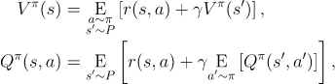
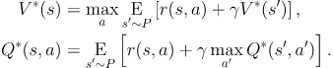
Bellman equations
The value of your starting point is the reward you expect to get from being there, plus the value of wherever you land next
The Bellman equations for the optimal value functions

Slide 25
Question
What is the Q-value of action leading to terminal state

Slide 26
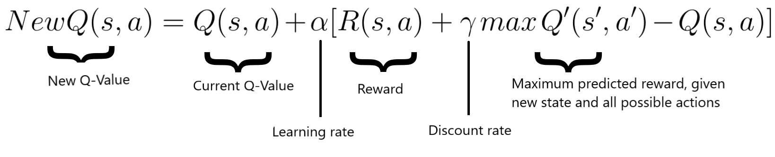
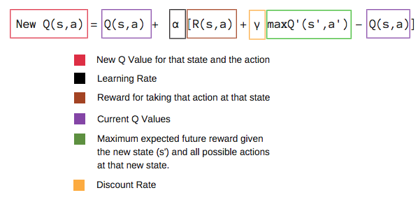
Q-Learning update rule

Slide 27
Gridworld demo

Slide 28
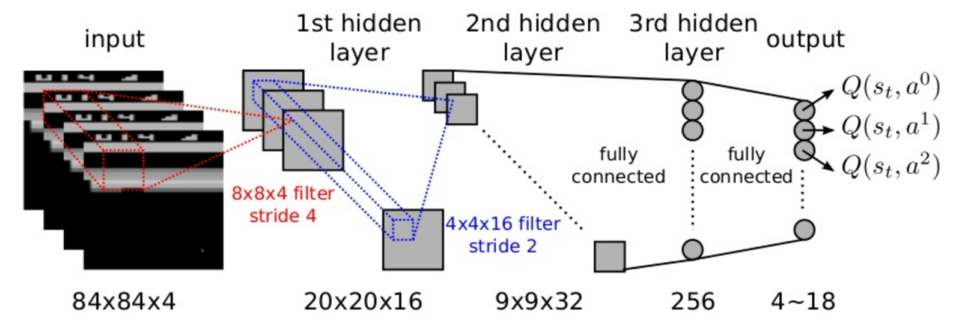
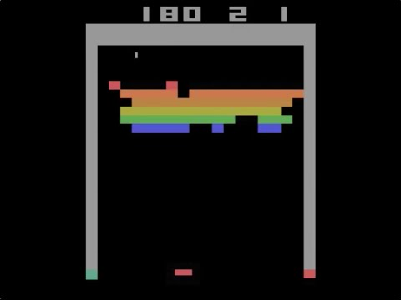
DQN: Learning from pixels

Slide 29
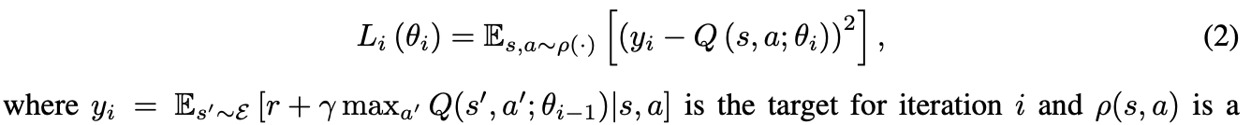

DQN: Learning from pixels
Loss function
Update rule

Slide 30
Experience Replay
Save all the transitions that in the memory. Use mini batches from memory for updates
Reduces correlation between experiences in updating DNN
Increases learning speed with mini-batches
Reuses past transitions to avoid catastrophic forgetting

Slide 31
Target Network
We fix parameters of target network and replaces them with the latest network Q network every thousands steps
Target Network Q

Slide 32
DQN: Code

Slide 33
Kaggle Simulations

